Slide 1
Black Jack
By Aidan Fearn

Slide 2
Agenda
Intro
Overview
Technical Details
Implementation
Challenges
User Experience
Demo
Lessons Learned
Conclusion
Aidan Fearn

Slide 3
Introduction
Black Jack
Play your favorite Casino game from the comfort of your home
Don’t risk real money
Give the player an authentic experience

Slide 4
Project Overview
- Get as close to 21 as you can without “busting”
- ”Hit”, “Stand”, “Double down” and “Split”
- User will use a real time balance’
- User will control the betting amount
- Goal is to make more money than you lose!

Slide 5
Technical Details
Python programming language
Random
Functions
Lists
Math
Enumerate
If statements
Loops

Slide 6
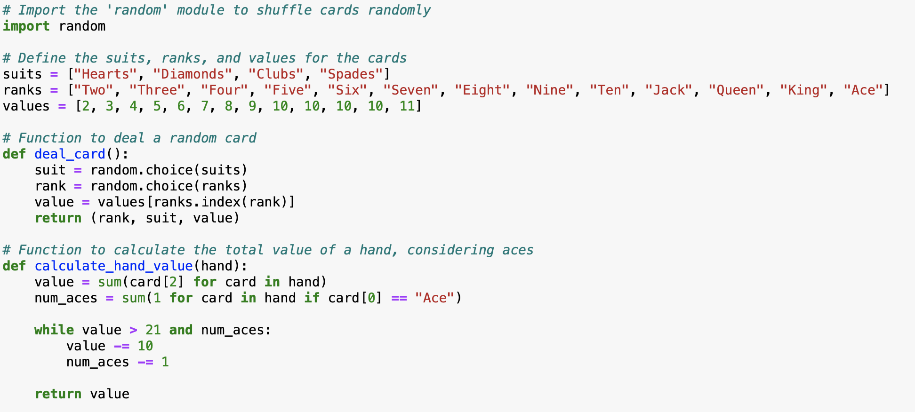
Implementation

Slide 7
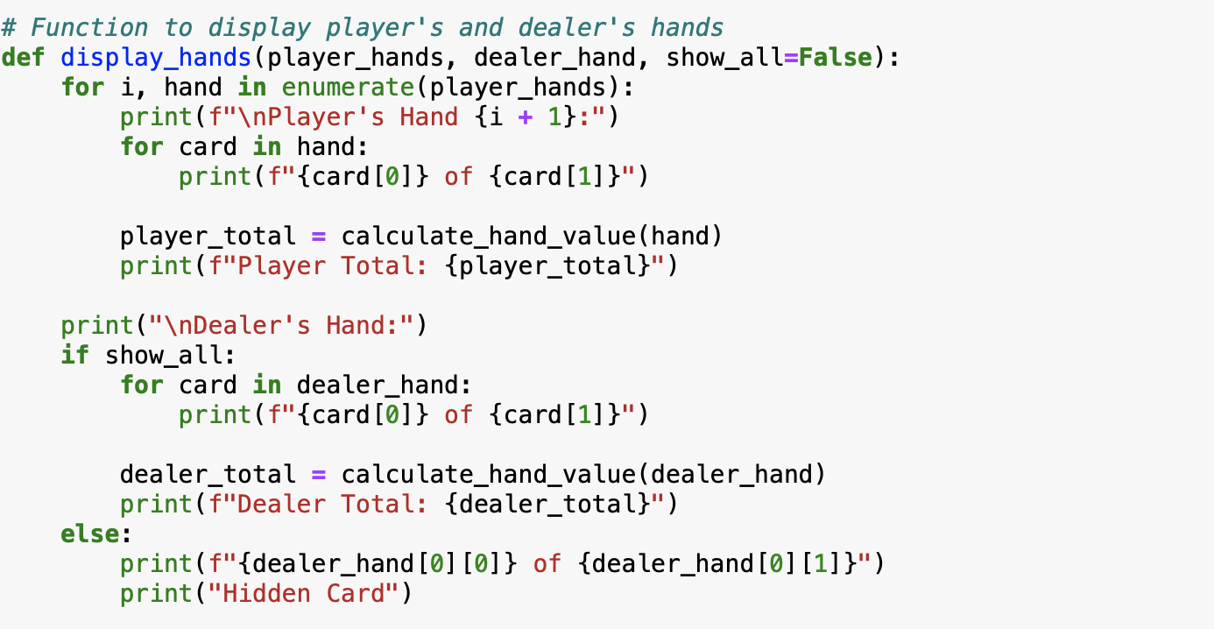
Implementation (2)

Slide 8
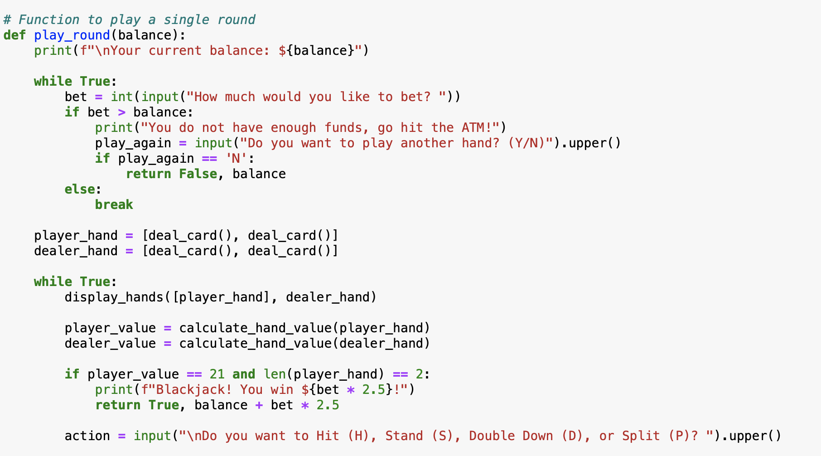
Implementation (3)

Slide 9
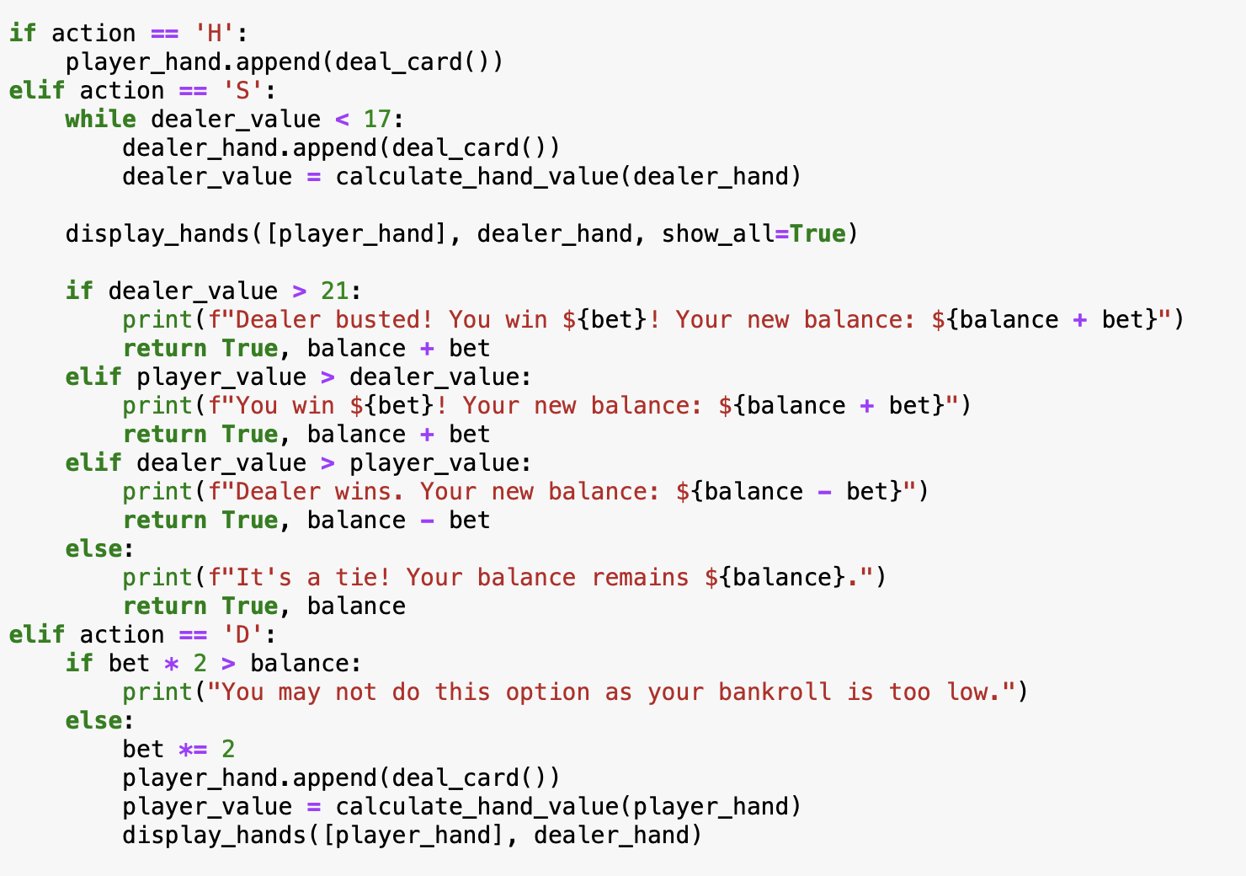
Implementation (4)

Slide 10
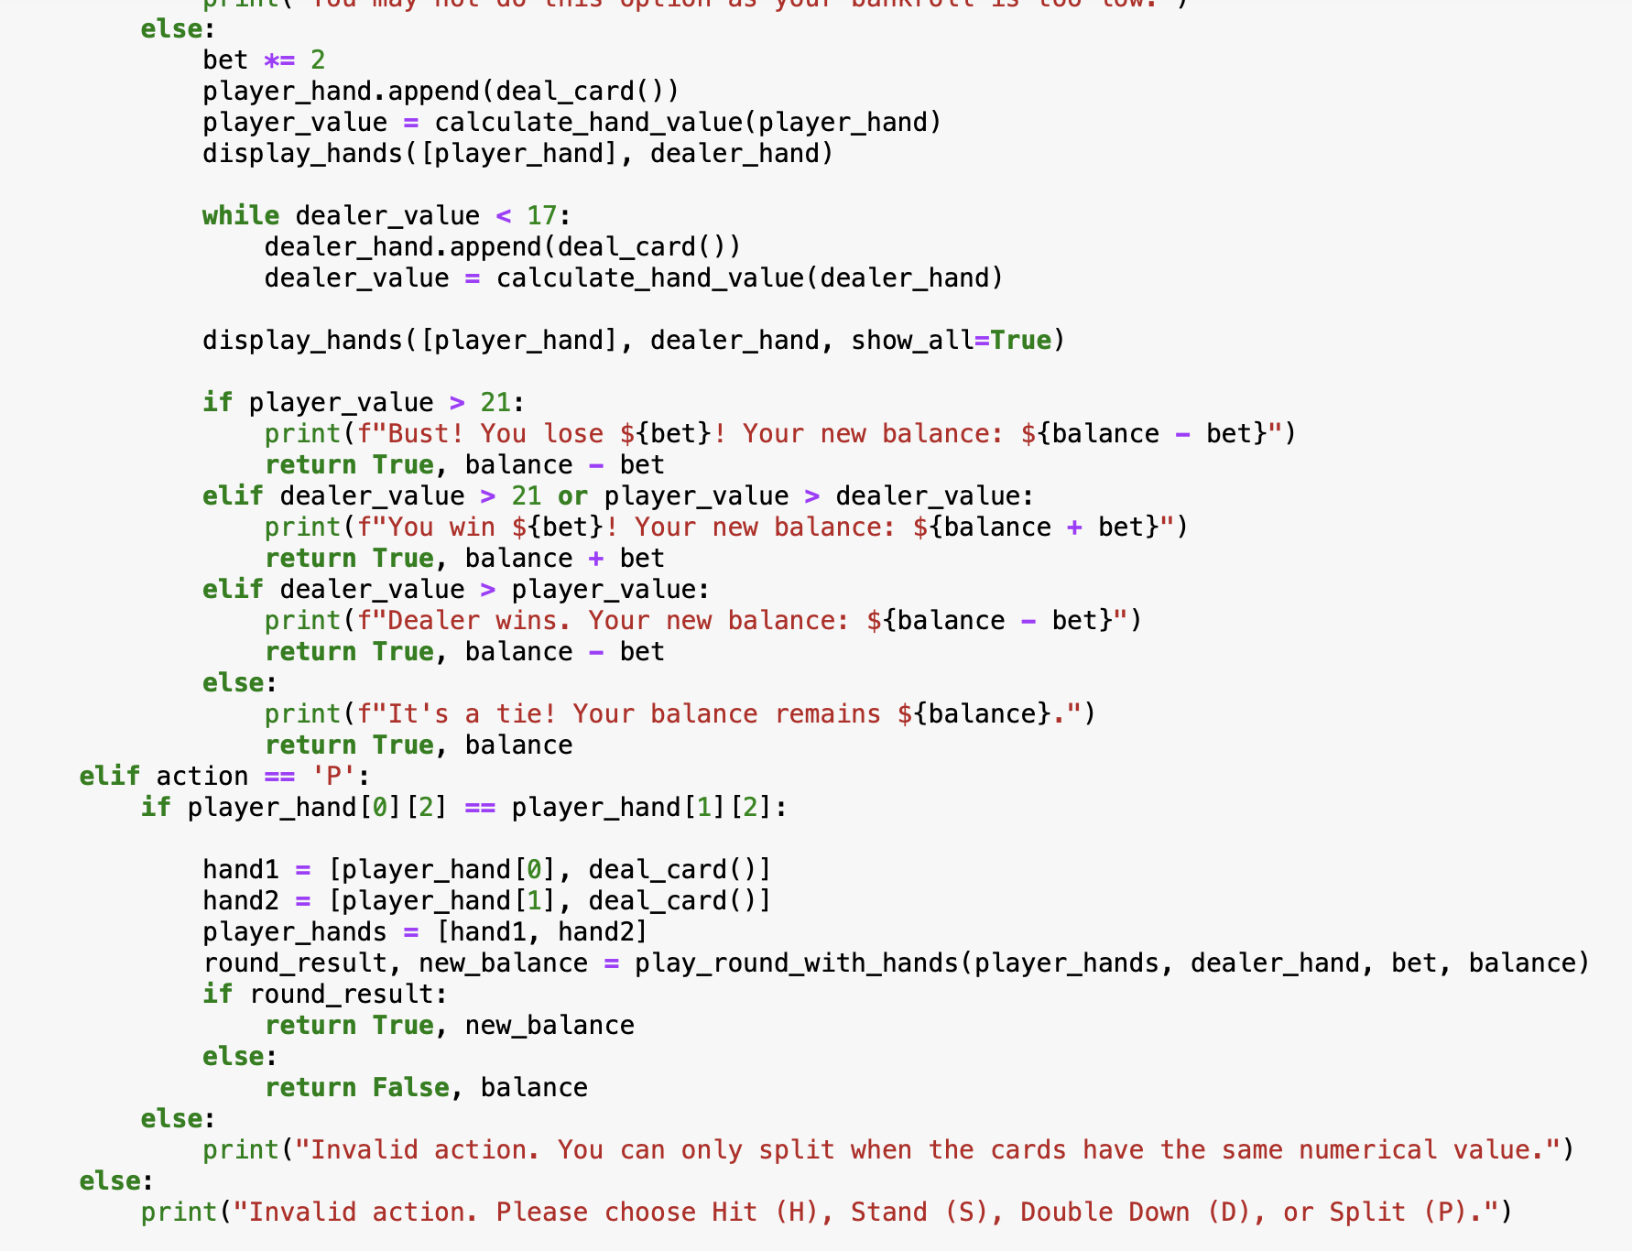
Implementation (5)

Slide 11
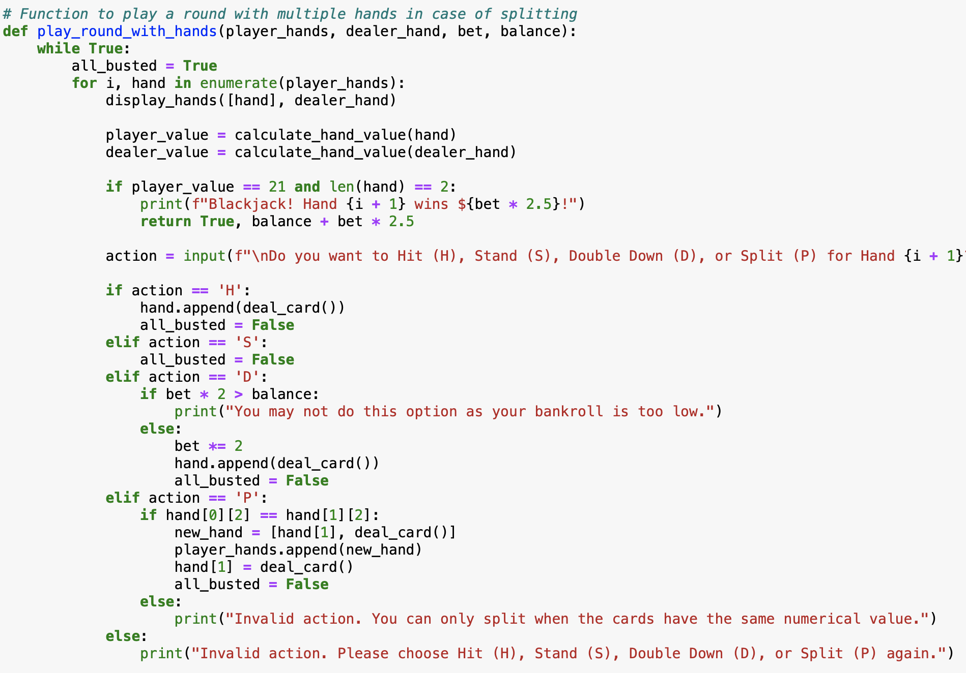
Implementation (6)

Slide 12
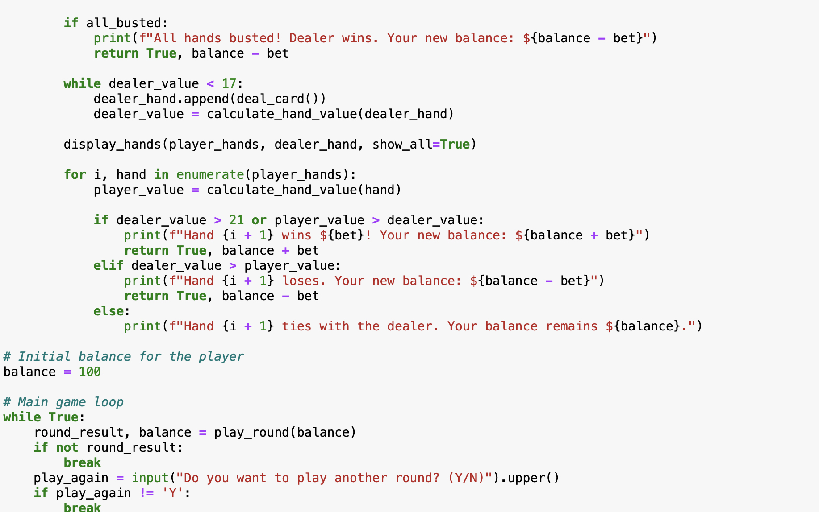
Implementation (7)

Slide 13
Challenges
Ensuring that the code would repeat if user selected “split” or “double down”
Implementing the “balance” feature
Breaking the code when users select “double down”
Allow the bets to multiply accordingly in the balance when user selects “split” or “doubledown”

Slide 14
User Experience
User starts off with balance
They select amount they want to bet
They play a hand and can hit, stand, dd or split
Result of the hand will either add to or deduct from the balance
Displays new balance
Asks user if they want to play another hand

Slide 15
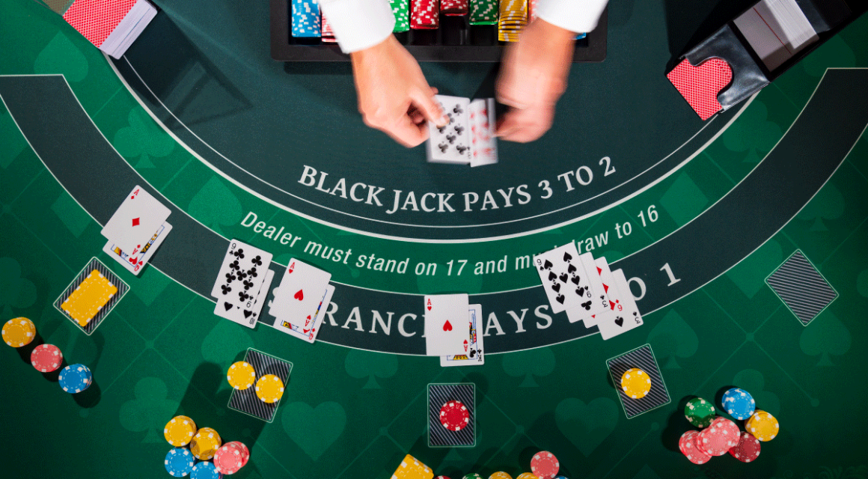
Demo

Slide 16
Lessons Learned
How to write python code to create black jack
How to use functions on numerous block of code
How to tie functions together using mathematical operations
Using the random feature
Gain experience with long block of code

Slide 17
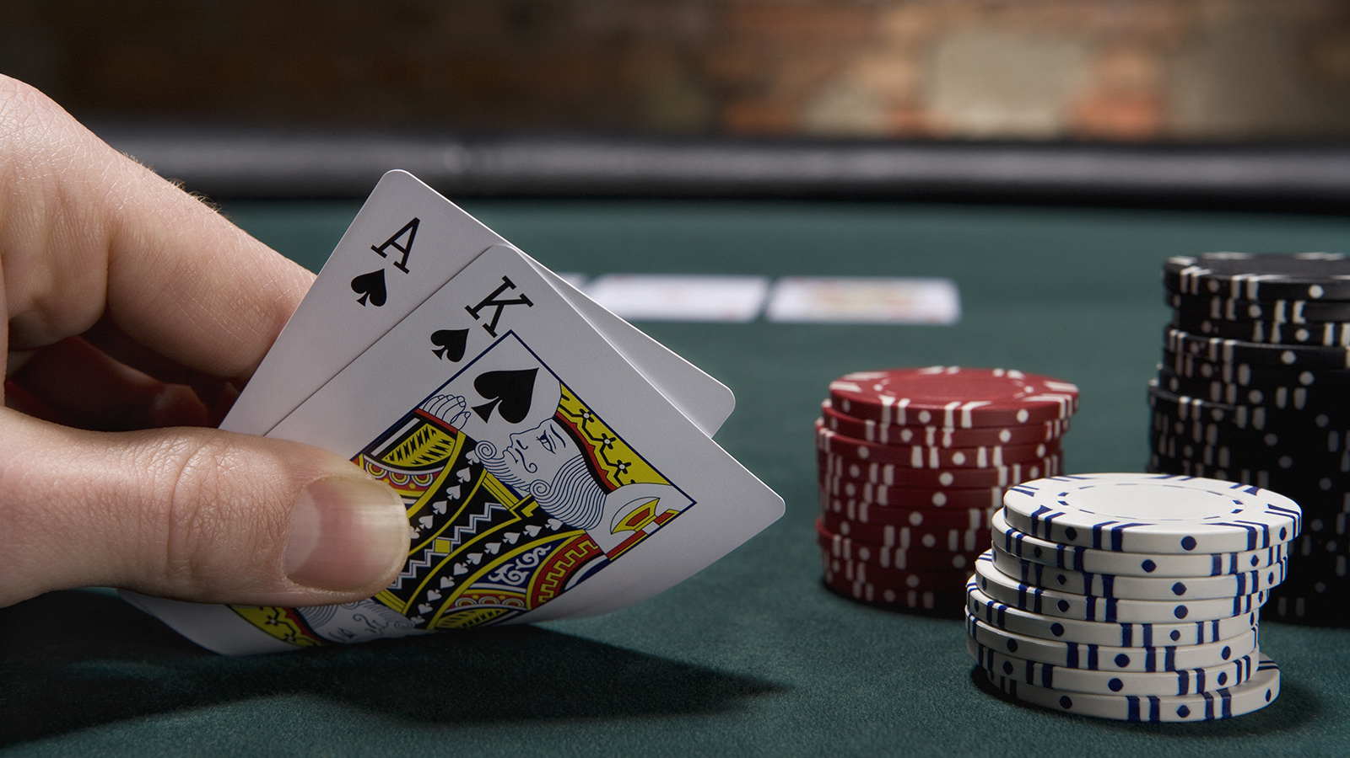
Conclusion

Slide 18
Thank You

